Slide 1


SIMATS ENGINEERING
SAVEETHA INSTITUTE OF MEDICAL AND TECHNICAL SCIENCES
SMART STORAGE OPTIMIZATION AND DUPLICATE FILE DETECTION SYSTEM USING C++
DSA0108 - OBJECT ORIENTED PROGRAMMING WITH C++
Presented by:
K.Namitha (192311205)
K.Harahini Sriya (192421283)
M.Mahi (192524411)
A.JAHNAVI (192472214)
Guided by:
JEGADEESH.K

Slide 2


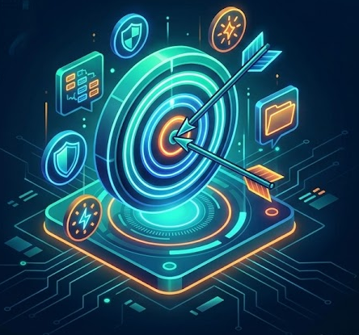
OBJECTIVES
File Scanning: Develop a C++ system to scan selected directories and collect file metadata.
Duplicate Detection: Identify duplicate files using SHA-256 hashing to compare file contents.
Storage Analysis: Analyze file sizes, modification dates, and duplicate groups to identify storage wastage.
Storage Optimization: Estimate recoverable storage space and generate prioritized cleanup recommendations.
Safe File Management: Implement user-approved file quarantine to prevent accidental permanent deletion.
File Recovery: Provide a recovery mechanism to restore quarantined files and improve data safety.

Slide 3
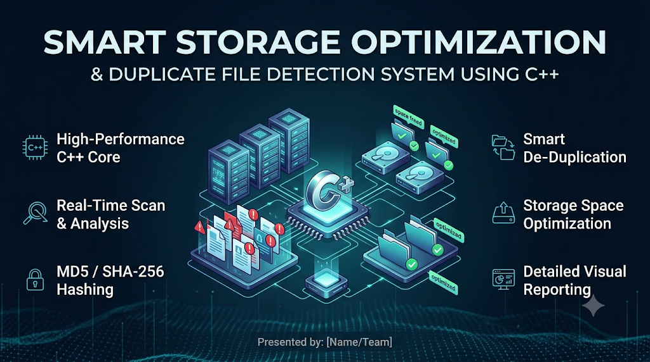
INTRODUCTION
The project develops a C++-based system for analyzing and optimizing computer storage.
It scans selected directories and collects file metadata such as name, size, extension, and modification date.
SHA-256 hashing is used to identify duplicate-file candidates based on file content.
The system analyzes storage wastage and recommends files for user review.
A quarantine and recovery mechanism supports safer cleanup and helps prevent accidental data loss.

Slide 4
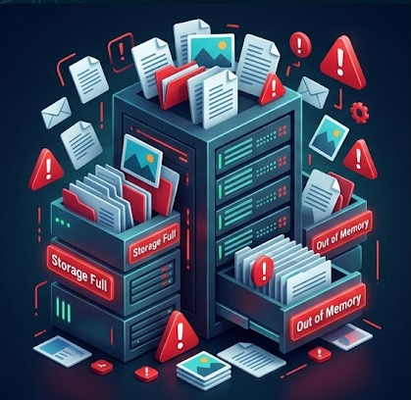
PROBLEM STATEMENT
Duplicate files stored in multiple folders consume unnecessary disk space.
Identifying duplicate files, large files, and old files manually is time-consuming and inefficient.
Users may struggle to determine how much storage space can be recovered.
Deleting files without proper verification can lead to accidental data loss.
Therefore, a C++-based system is needed to detect duplicate files using SHA-256 hashing, analyze storage wastage, recommend potential cleanup actions, and provide safe file quarantine and recovery.

Slide 5
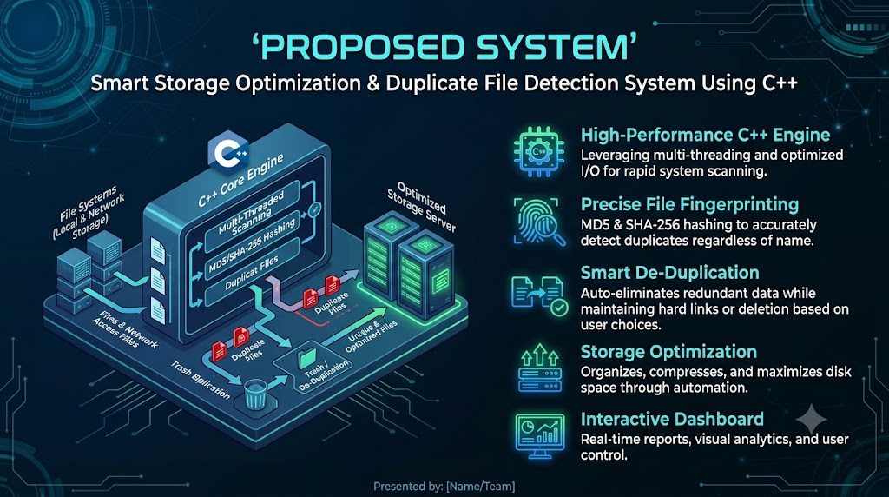
  PROPOSED SYSTEM
Develop a C++-based application to scan selected directories and collect file metadata.
Use SHA-256 hashing to identify duplicate files based on their content.
Analyze file sizes and modification dates to identify large and old files.
Calculate duplicate storage wastage and estimate potential recoverable space.
Generate prioritized cleanup recommendations to help users identify files for review.
Provide user-approved quarantine and file recovery to reduce the risk of accidental data loss.

Slide 6
  LITERATURE REVIEW
S. No. | Year | Research Paper / Topic | Key Findings | Research Gap / Limitation
1 | 2023 | Ellappan and Murugappan – A Smart Hybrid Content-Defined Chunking Algorithm for Data Deduplication in Cloud Storage | Proposes a hybrid chunking method to improve data deduplication in cloud storage. | Focuses on cloud-based chunking rather than local file scanning and cleanup.
2 | 2024 | Data Deduplication and Redundancy Reduction Approaches | Hash-based fingerprinting and chunking help identify and reduce redundant data. | Does not represent a specific standalone 2024 paper; further source verification is needed.
3 | 2025 | File Hash Comparison for Duplicates Using AI – International Conference on Computer and Applications | Combines SHA-256 hashing and AI techniques for duplicate-file detection. | Less emphasis on storage-waste analysis and safe file recovery.
4 | 2026 | Kaur et al. – Machine Learning-Based Data Deduplication: Techniques, Challenges, and Future Directions | Reviews machine-learning techniques, scalability challenges, and future directions in deduplication. | The proposed project focuses on exact file matching using SHA-256 rather than ML-based deduplication.
5 | 2026 | Kui et al. – Systematic Classification and Performance Analysis of Data Deduplication and Reduction Techniques | Classifies deduplication methods and examines performance, efficiency, and reliability. | Does not specifically combine local file scanning, ranked cleanup recommendations, and recovery.

Slide 7
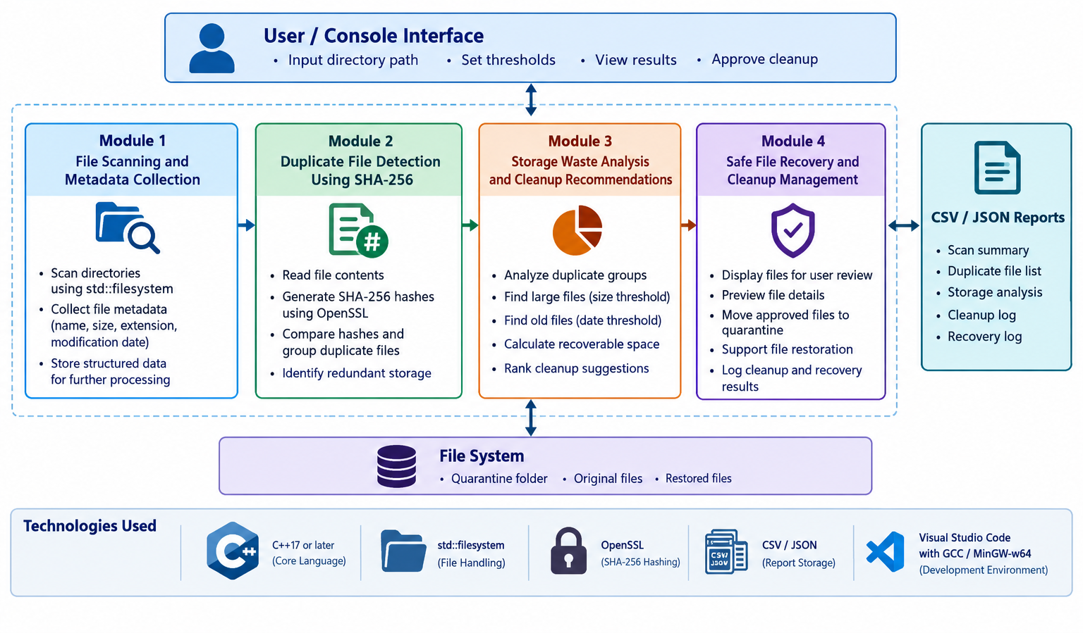
SYSTEM ARCHITECTURE DIAGRAM

Slide 8
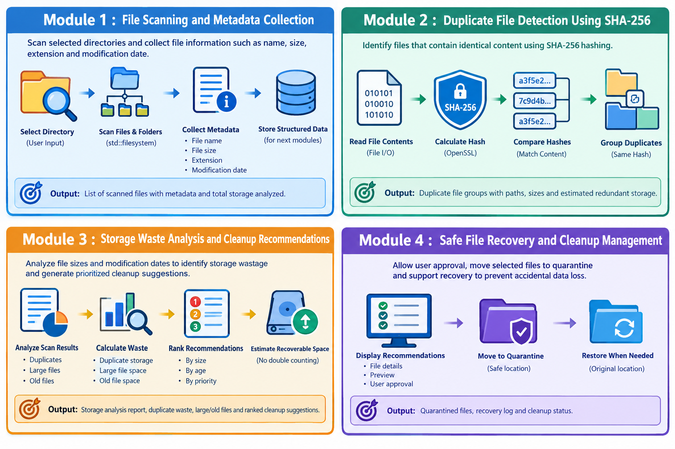
MODULE 1
FILE SCANNING AND METADATA COLLECTION
Purpose: To scan selected directories and collect structured information about files.
Key points:
Accept the directory path provided by the user.
Scan files and subdirectories using std::filesystem.
Collect filenames, file sizes, extensions, and modification dates.
Organize collected metadata for subsequent duplicate detection and analysis.
Record the total number of files scanned and the total storage analyzed.
Expected output: A list of scanned files with their paths, sizes, extensions, and modification dates.

Slide 9
MODULE 2
DUPLICATE FILE DETECTION USING SHA-256
Purpose: To identify files that contain identical content.
Key points:
Read the contents of files selected for hashing.
Calculate a SHA-256 hash for each file using OpenSSL.
Group files with matching hashes as duplicate candidates.
Compare file sizes as a preliminary filtering step where appropriate.
Report duplicate groups and their potential storage wastage.
Expected output: Duplicate file groups with their paths, sizes, and estimated redundant storage.

Slide 10
MODULE 3
STORAGE WASTE ANALYSIS AND CLEANUP
RECOMMENDATIONS
Purpose: To analyze storage usage and prioritize potential cleanup opportunities.
Key points:
Calculate storage occupied by duplicate file groups.
Identify files exceeding the configured large-file threshold.
Identify files older than the configured age threshold.
Estimate recoverable space without double-counting files.
Rank cleanup recommendations to help users make informed decisions.
Expected output: Storage analysis results, identified files, duplicate waste estimates, and prioritized cleanup suggestions.

Slide 11
MODULE 4
SAFE FILE RECOVERY AND CLEANUP MANAGEMENT
Purpose: To manage file cleanup safely while preserving the ability to restore files.
Key points:
Display recommended files for user review.
Allow the user to preview file details before cleanup.
Require explicit approval before moving selected files.
Move approved files to a designated quarantine location instead of permanently deleting them.
Support file restoration and report cleanup and recovery outcomes.
Expected output: A record of approved cleanup actions, quarantined files, restoration attempts, and recovery status.

Slide 12
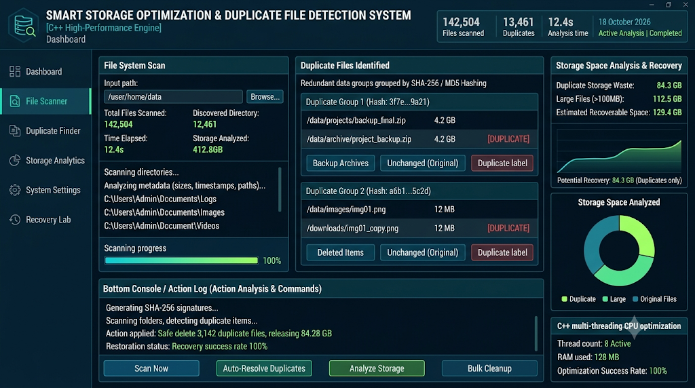
IMPLEMENTATION

Slide 13
ADVANTAGES
Automated scanning: Reduces the effort required to examine files manually.
Duplicate detection: Identifies files with matching SHA-256 hashes.
Improved storage visibility: Highlights duplicate, large, and old files.
Storage optimization: Estimates potential storage recovery opportunities.
Data safety: Uses user approval and quarantine before cleanup.
File recovery: Supports restoring quarantined files when necessary.
Modular design: Separates scanning, detection, analysis, and cleanup into manageable components.
Local processing: Can analyze files directly on the computer without requiring a cloud service.

Slide 14
CONCLUSION & FUTURE SCOPE
The project proposes a C++-based solution for intelligent file scanning and storage optimization.
It combines metadata collection, SHA-256 duplicate detection, and storage waste analysis.
It generates cleanup recommendations based on duplicate status, file size, and modification age.
User-approved quarantine and recovery provide a safer alternative to immediate permanent deletion.
The modular design demonstrates practical applications of C++17, filesystem operations, hashing, data structures, and file handling.
Future scope:
Develop a graphical user interface with storage charts.
Add scheduled scans and automatic report generation.
Improve scanning performance for large directories.
Add configurable exclusion rules and more advanced storage analytics.

Slide 15


